Slide 1
Data Structure and Algorithms
Link List
Farhan Shafiq , Ph.D.
farhanshafiq@fuuast.edu.pk

Slide 2
A linked list is a linear data structure, in which the elements are not stored at contiguous memory locations. The elements in a linked list are linked using references (pointers).
a linked list consists of nodes where each node contains a data field and a reference(link) to the next node in the list.

Slide 3
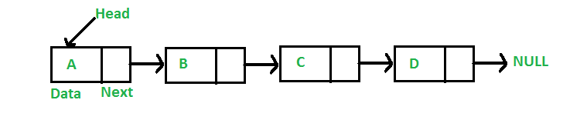
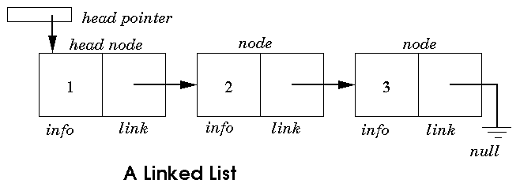
Link List
info-=Data Next=Link=Pointer to next node

Slide 4
In Link-list
Each element or Node, of a list is comprising of two items - the data and a reference to the next node.
The last node has a reference to null.
The entry point into a linked list is called the head of the list.
It should be noted that head is not a separate node, but the reference to the first node.
If the list is empty then the head is a null reference.

Slide 5
A linked list is a dynamic data structure.
The number of nodes in a list is not fixed and can grow and shrink on demand.
Any application which has to deal with an unknown number of objects will need to use a linked list.

Slide 6
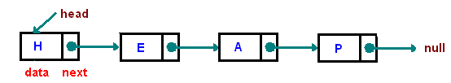
Types of Linked Lists
A singly linked list
  Describe in previous slides
  Node(data+link)
  Last link=Null
  Traverse in only One Direction
A doubly linked list

Slide 7
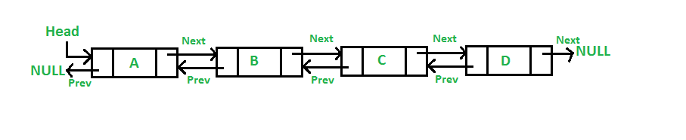
A doubly linked list is a list that has two references, one to the next node and another to previous node.

Slide 8
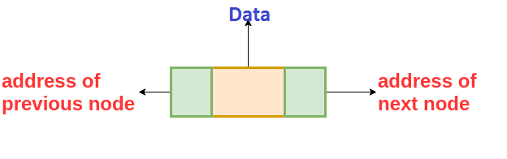
A Doubly Linked List contains an extra pointer, typically called previous pointer, together with next pointer and data which are there in singly linked list.
here we are storing the address of the next as well as the previous nodes.

Slide 9
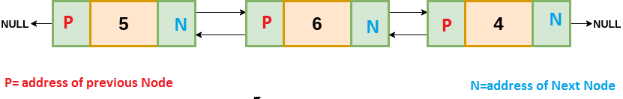
The nodes are connected to each other in this form where the first node has prev = NULL and the last node has next = NULL.

Slide 10
Circular Linked List
A circular linked list is either a singly or doubly linked list in which there are no NULL values.
We can implement the Circular Linked List by making the use of Singly or Doubly Linked List.

Slide 11
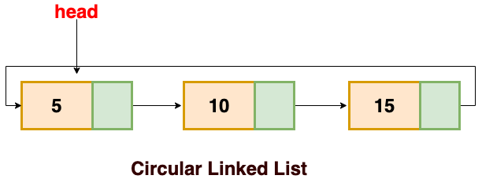
In the case of a singly linked list, the next of the last node contains the address of the first node

Slide 12
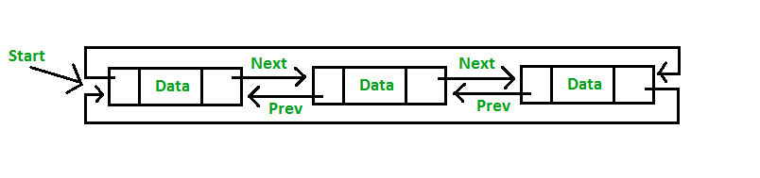
In case of a doubly-linked list, the next of last node contains the address of the first node and prev of the first node contains the address of the last node.

Slide 13
Operations on Link List
Traversal: To traverse all the nodes one after another.
Insertion: To add a node at the given position.
Deletion: To delete a node.
Searching: To search an element(s) by value.
Updating: To update a node.
Sorting: To arrange nodes in a linked list in a specific order.
Merging: To merge two linked lists into one.

Slide 14
Operation will be discus in Class

